Slide 1

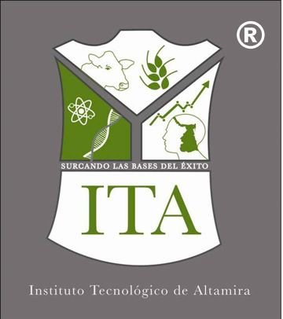
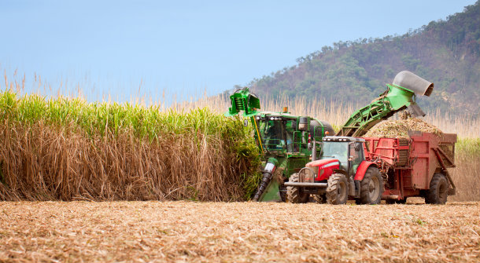
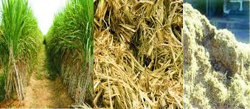
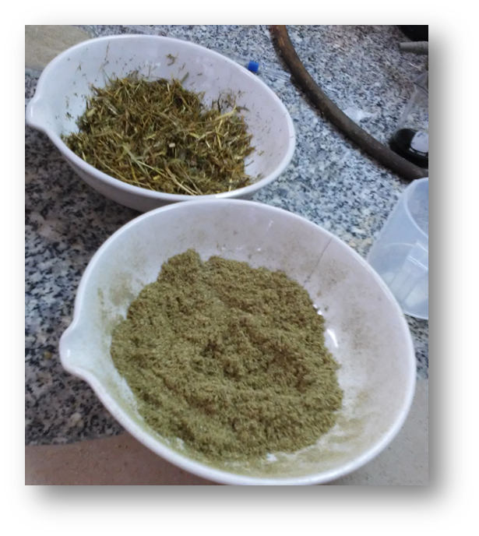
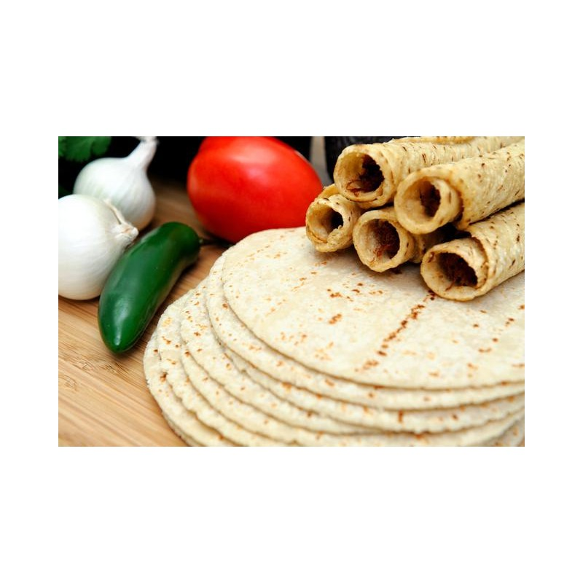
María Elena Sánchez-Pardo^{b}, D. I. Llanes Gil-López¹, J. A. Lois-Correa. ªInstituto Politécnico Nacional , CICATA-Altamira, CIAMS, km 14.5 Carr. Tampico-Pto. Ind. Altamira, Altamira, Tamps. México
^{b}Instituto Politécnico Nacional, ENCB-Unidad Profesional Adolfo López Mateos, Av. Wilfrido Massieu Esq. Cda. Manuel Stampa s/n, Del Gustavo A. Madero, Ciudad de México.
Alkaline treatment with microwave-assisted of
sugar cane for increasing nutraceutical properties
ABSTRACT
Sugarcane bagasse contributes a source of dietary fiber, antioxidants such as polyphenol and policosanol. The alkaline treatment with microwave-assisted flour was evaluated by confocal laser scanning microscopy; starch granules and cellulose were observed. An 8% increase in antioxidants was achieved in the formulation with corn flour-SCB; this mix provides dietary fiber and antioxidants.
Keywords: microwave-assisted alkaline, sugar cane bagasse, dietary fiber, antioxidants.
INTRODUCTION
METHODOLOGY
Alkali treatment
* NaOH 2%
*Immersion Ț: 10 min
Drying
Microwave oven 5 min
*Power = 600 w
Filtering and washing
(pH= distilled water)
Inclusion of Process in making “tortilla”
Sugar Cane Bagasse
RESULTS
Table 1. Physical-chemical composition of the tortilla made with corn-SCB dough
Tortilla |  | μMol trolox / g dry sample (antioxidant capacity | % inhibition ABTS ⁺⁺ | dietary fiber g /100 g
Corn-SCB | 20.63±0.4 |  | 22.21 ±0.2 | 24.8 ±2.3
Corn 100% (control) | 10.85 ±0.3 |  | 14.87 ±0.13 | 7.91 ±0.4
Figure 1. Image of to tortilla CLSM made with corn-SCB dough, with selective calcofluor staining for cellulose, in blue (a), and fluorescein for starch (b).
Conclusions:
SCB fibers in human foods, based on corn, provide dietary fiber and antioxidants. statistically, there is no difference in texture and flavor between the tortilla made with corn flour-scb and the control product (traditional corn tortilla). an 8% increase in antioxidants was achieved in the formulation with corn flour-scb. this increase is greater than in similar foods.
Acknowledgement:
Authors wish to thank COFAA-IPN, CONACYT and IPN for scholarship grant and financial support through the Projects SIP 2017-0761, 20160764

